Slide 1
WELCOME AT MATE
KÁROLY RÓBERT CAMPUS!
Academic year 2024/25

Slide 2
Educational/
non-educational issues
Educational issues (please see your educational coordinator,their names are on the 3. and 5. slide)
Any questions related to
Enrollment
Subject registration
Subject recognition
Issues with Neptun
Student ID, student status certificate, transcript
Thesis
Non-educational issues (please see Mrs.Barbara Tátrainé Biró)
Any question related to
Residence permit
Bank account
TAX number
Public health insurance, private health insurance

Slide 3
Non-educational coordinators, SH coordinators
Office hours
HEAD OF INTERNATIONAL RELATIONS CENTER: Institutional Coordinator for Erasmus, CEEPUS | Zsuzsanna Tarr, PhD | tarr.zsuzsanna@uni-mate.hu Gödöllő, Main building, ground floor, room 29-31. Phone: +36 28 522 000 / 1017 | Mon-Thurs 13:30-15:00
Stipendium Hungaricum Institutional Coordinator | Csilla Kánai | kanai.csilla@uni-mate.hu Gödöllő, Main building, ground floor, room 29-31. Phone: +36 28 522 000 / 1014 | Mon-Thurs 13:30-15:00
International Coordinator (SH, DFP, FAO, MISP, Self-finance) Student Services – non-educational issues | Judit Tallárom-Czingili | tallaromne.czingili.judit@uni-mate.hu Gödöllő, Main building, ground floor, room 29-31. Phone: +36 28 522 000 / 3882 | Mon-Thurs 13:30-15:00
International Office/Registrar’s office Adminisrator | Barbara Tátrainé Biró | Tatraine.biro.barbara@uni-mate.hu Gyöngyös, A Building, 1st floor 1.206 office Phone: +36 37 518-394 | Mon, Wed, Thu 09:00-12:00

Slide 4
International Relations Office - Gyöngyös
Responsible for:
1. Scholarship student administration of Stipendium Hungaricum and Christian Young People scholarship programme by phone, e-mail
2. Residence permit administration
3. Tax number administration
4. Administration related to opening a bank account
5. TAJ card administration
6. Scholarship extension, postponement
7. Issuance of certificates to individual organizations, foreign partners and embassies
8. Program organizing for our international students
9. Up-to-date scholarship and event information for students (deadlines, tasks, rules, etc.)

Slide 5
Educational coordinators
Office hours
 | Ms Ildikó VÉGH Head of Study Registrar’s Mrs Barbara Tátrai Biro Study Administrator 1. Issuance of certificates - certificate of student status, transcript of records, certificates related to studies / self-finance procedure / credits obtained, certificates requested by embassies, certificate of continuing studies in English, diploma certificates 2. Applying for a student card, receiving a student card, validating a student card 3. Admission assistance 4. Answering questions related to studies 5. Assistance with applications 6. Dealing with problems with the Neptune system 7. Issues related to scholarships and housing benefits | vegh.ildiko@uni-mate.hu Gyöngyös, A Building, 1st floor Phone: +36 37 518-307 tatraine.biro.barbara@uni-mate.hu Gyöngyös, A Building, 1st floor 1.206 Phone: +36 37 518-394 | Mon, Wed, Th 09:00-12:00 Mon, Wed, Th 09:00-12:00

Slide 6
Other useful contacts
Office hours
MATE Dormitory Director – Gyöngyös | Mr. Márk Lakatos | Lakatos.mark@uni-mate.hu
Library in Gyöngyös | Ms. Lilla Gyurgyik | konyvtar.gyongyos@uni-mate.hu | Mon, Wed 8:00-14:00 Tue, Thurs 10:00-16:00 Fri 8:00-13:30

Slide 7
Mentorship
The members of the KRC HÖK are primarily the institutionalized organization of student interest representation within the campus.
Ms Anna Orsolya Bazsó – Representative for foreign affairs bazso.anna.orsolya@stud.uni-mate.hu

Slide 8
MATE Károly Róbert Campus International Fb group
MATE Károly Róbert Campus International Fb group:
https://www.facebook.com/groups/522058731474083

Slide 9
NEPTUN
Your education related issues are registered in NEPTUN SYSTEM.
For activation of your Neptun profile, please, follow the instructions:
https://en.uni-mate.hu/neptun-system
Please, activate your MATE ID as well:
https://joker.uni-mate.hu
https://en.uni-mate.hu/mate-authentication-wifi-e-learning-email-

Slide 10
Neptun Education System
A useful video on how to use Neptun can be found on the link below:
https://www.youtube.com/watch?v=Cz_mf6Y98Ec
NEPTUN GUIDE
www.neptun.uni-mate.hu

Slide 11
Education related tasks or issues
Enrollment
Subject registration
Subject recognition
Forms of subject assessment
Exams
Number of credits to be completed
Need a document
Student ID

Slide 12
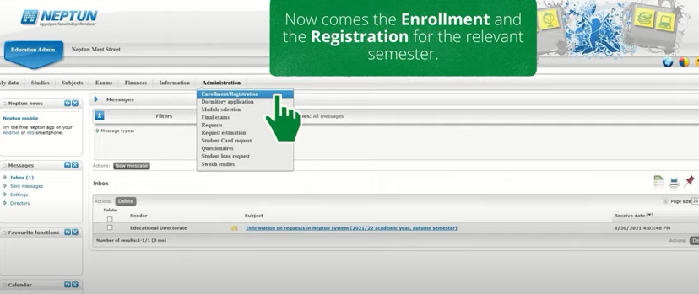
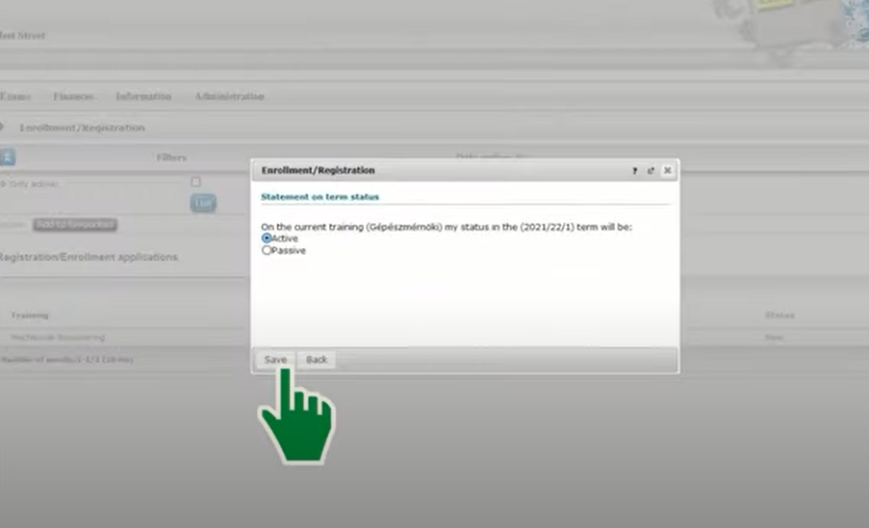
Enrollment from August 25th- September 4th
Administration → Enrollment/registration

Slide 13
Subject registration from August 25th- September 11th
Subjects/Register for subjects

Slide 14
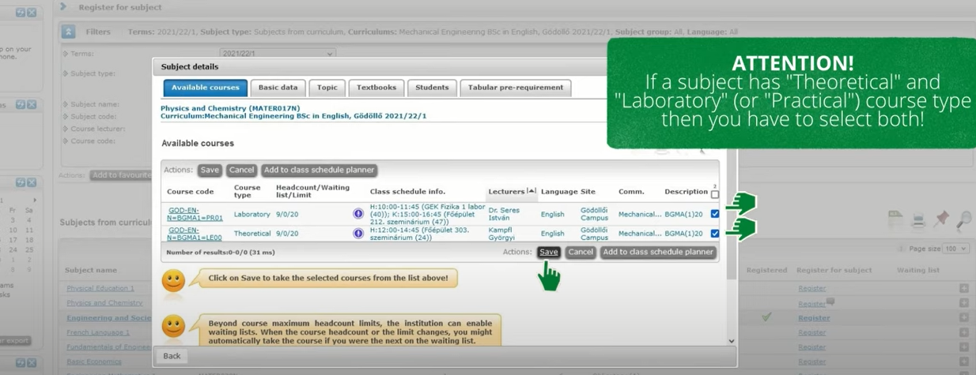
Subject registration from August 28th- September 10th

Slide 15
Subject registration additional information
Please keep in mind that any subject can be registered only once for free of charge.
If you cannot complete a certain subject, the second registration is 2000 HUF.
Pay attention to the preliminary requirements of subjects during your studies!
We recommend you to take the subject by the method of the model curriculum. In the fall semester of the 2022/2023 academic year, the subjects prescribed for the first semester must be taken.
You can find the model curriculum here: Neptun→Studies→Curriculum
After the subject has been taken, it will immediately appear in the Timetable information when the classes will take place.

Slide 16
Subject recognition process
If you have a subject competed during previous studies, and you would like to get it recognized, the process is the following:
You have to submit a request in Neptun.
Choose ”Studies” menu, then Curriculum.
The right curriculum has to be chosen, then choose ”list subjects”. At the end of the row, click on +, and choose submitting request.
For students transferred from another HEI, or former graduated students of another HEI : 3.000 HUF/subject;
for former students of MATE: free of charge
The fee is transcribed after decision.
HEI: Higher Educational Institute

Slide 17
Forms of subject assessment, participation in classes – extract Please read our regulation carefully!
3.2. Forms of subject assessment 3.2.1. Signature, end-of-semester signature Section 47 (47.§) PAGE 57
(1) The end-of-semester signature is a recognition of the fulfilment of the study requirements of the given subject during the semester, and in case of a subject to be completed by another assessment method, it is one of the conditions for registering for the examination. The conditions for obtaining the signature must be defined in the study requirements for the subject by the subject leader, including the conditions for rejecting it and for the repeated attempt to obtain it.
2. Participation in classes Section 45 (45. §) PAGE 55
(1) Lecture attendance is an integral part of the learning process but students cannot be required to attend lectures by administrative means.
(2)Participation and fulfilment of practical requirements in practices, seminars, laboratory practices, field practices (study visit, workshop) are mandatory.
(3)The permissible extent of absence from the types of lessons referred to in paragraph (2), regardless of whether justified or not, is one quarter of the classes of the given subject in full-time work schedule, rounded to the nearest whole number according to the rounding rules; in case of correspondence work schedule, it is one third of practical classes, seminars, field practice classes, laboratory classes. If the absence rate exceeds this, the subject leader shall refuse to sign the semester.

Slide 18
EXAMS
Exam registration is available until the day before the exam takes place until 12 o'clock. (noon) Example: Test on Tuesday, registration closes on the Monday before at 12 o'clock (noon)
A signature registered in Neptun is a must, otherwise you are not able to register for the exam.
If a student fails the exam, the first retake is for free of charge, but before the second retake 2000 HUF exam fee has to be paid.
If you have any active debt in Neptun, you are not able to register for any exams.
If you pass an exam but you are not satisfied with your result, the grade can only be imroved in the same semester.
Keep in mind that final examination otherwise known as graduation examination has different rules.

Slide 19
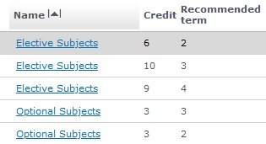
CREDITS
The minimum number of credits to be completed is 210 on BSc level and 120 on MSc level, until the end of your studies.
In case of a preparatory programme, 60 credits has to be completed.
Make sure that you complete the minimum credit number of A (mandatory/obligatory) B (mandatory elective) C (optional) subjects, as it is described in your curriculum.
Neptun (Studies->curriculum)
choose every subject,
click … icon
list subjects
Click on ’ name’ to see the number of credits
How to check it

Slide 20
NEED A DOCUMENT
Student status certificate
Transcript
In NEPTUN choose Administration menu/Requests/Application for printed document or write an email to your international coordinator.
Syllabus
Find it in Neptun (Subjects/Registered subjects, click + at the end of the row, then download syllabus)
or write an email to the professor in charge.
MATE Phonebook: www.telefonkonyv.uni-mate.hu

Slide 21
STUDENT ID
After your arrival you will get a temporary Student ID from the Registrar’s Office. It entitles you to buy a student ticket at a discount price for public transportation incl. monthly passes, student entrance fees in exhibitions, museums, concerts etc. The temporary student ID is valid for 2 months. Before it expires, please go to the Registrar’s Office to ask for a new one. Temporary student ID is equivalent to the student card.
Temporary student ID can be issued once, you have to apply for a plastic ID card.
You have to apply for permanent Student ID (student card) at Governmental Offices (Kormányhivatal – Okmányiroda) for free.
Required documents:
passport
student status certificate (in Hungarian!)
1) The officers will take a photo of you, and issue a document: a NEK data sheet with a so-called NEK code. The student ID application should be registered in your NEPTUN account under
Administration / Student card request / ”Add new”
You have to type in the NEK code/identifier (NEK kód) that you can see on your NEK data sheet in the top right corner. Type without hyphens and click on SAVE. 2) Your NEK data sheet has to be uploaded into your Neptun account either in pdf or in jpg format:
Information > Documents > Upload document >> Choose "NEK adatlap" from the drop-down menu >> Upload file > Save
IMPORTANT: All data, names, address etc. on your NEK data sheet should be identical with your data in NEPTUN and in your passport!

Slide 22
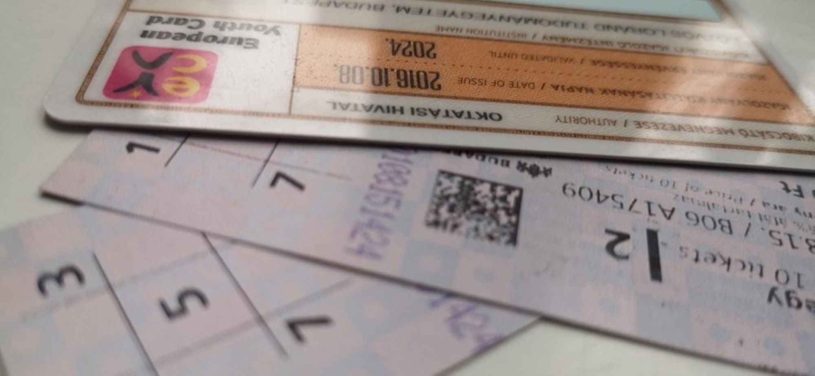
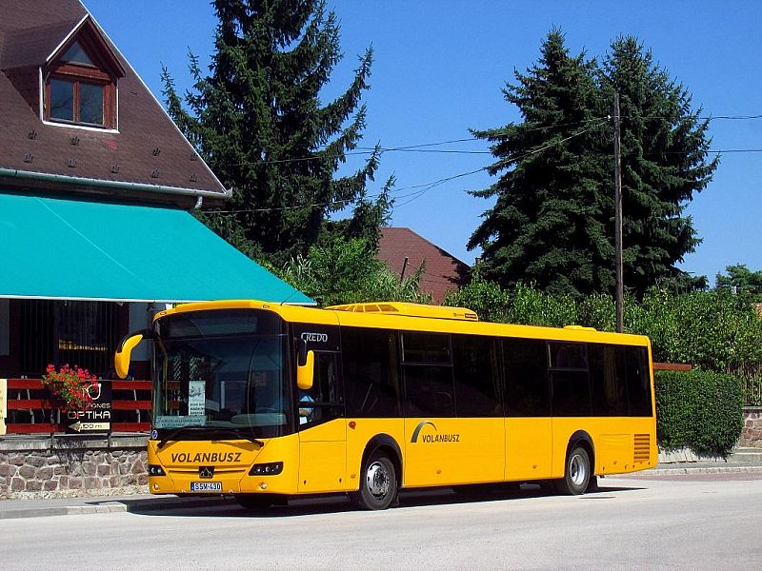
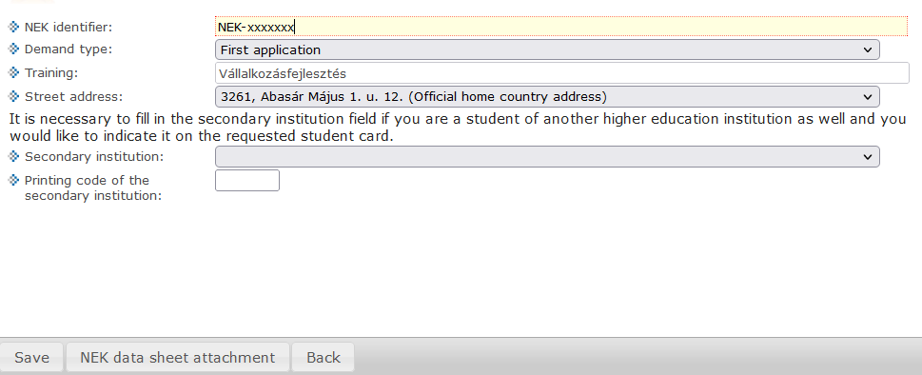
STUDENT ID
ADDRESS of the Governmental Office (Kormányhivatal – Okmányiroda) in GYÖNGYÖS: Gyöngyös, Göncz Árpád út 2.
Mon 8:00–18:00
Tue 8:00–14:00
Wed 8:00–18:00
Thur 8:00–16:30
Fri 8:00–13:30
You are going to get a data sheet with a „NEK IDENTIFICATION” number.
Steps to fix this number into the NEPTUN system:
Administration→Student Card request→Add new→
Write the NEK number here
Choose the first application option
Address of the dorm or apartment where you live
Push the Save button

Slide 23
ACADEMIC CALENDAR and useful websites

Slide 24
ACADEMIC CALENDAR
Available on the website of the Directorate of Education (oig.uni-mate.hu):
https://ed.uni-mate.hu/academic-calendar

Slide 25
en.uni-mate.hu
oig.uni-mate.hu
telefonkonyv.uni-mate.hu
Read for
General information
News
Information on SCHOLARSHIPS
Practical matters
Read for
MATE Organizational and Operational Regulations
Academic calendar
Electronic requests
Tution fee information
Read for
Contact details of professors.
It is the phonebook of the university.
WEBSITES TO CHECK

Slide 26
Stipendium Hungaricum Scholars -useful information
https://stipendiumhungaricum.hu/

Slide 27
STIPENDIUM HUNGARICUM SCHOLARS
CHANGING STUDY PROGRAMME / LANGUAGE / INSTITUTION
In case you want to change your study programme and/or the language of instruction and/or the institution you have to submit a request to Tempus Public Foundation (stipendiumhungaricum@tpf.hu) attaching the following documents:
- an approval letter signed by the head of your current institute - an acceptance letter from the new institution (in case you want to change only the language of instruction, there is no need for this) - a support letter from the sending partner (authority) in your home country
Deadline: in autumn semester: 1st December in spring semester: 15th May

Slide 28
STIPENDIUM HUNGARICUM SCHOLARS
► EXTENSION
In case you want to extend your studies, according to the Operational Regulations, you have to submit your request for extension to the university (by filling in the following form: https://limesurvey.szie.hu/index.php/283126?lang=en) and, at the same time, to the sending partner (authority) in your home country, but you do not have to wait for their approval since they will be contacted by Tempus directly.
The following documents must be attached (uploaded) to your request: - support letter signed by the head of the institute - transcript of records (list of subjects you have completed)
Deadline within the university in autumn semester: 15 November, in spring semester: 30 April
Please, note: „During the extension period, scholarship holders may not receive a scholarship or housing allowance. This shall first be applied to students starting their studies in the 2020/21 academic year in an ascending order.” (see Operational Regulations III.4.1.)
In case you have questions, you can contact us at sh@uni-mate.hu

Slide 29
CREDIT MINIMUM FOR SH scholars
stipendiumhungaricum.hu Scholarship holders menu, Rights/obligations
III.3. Further Obligations of the Scholarship Holders
6. The scholarship holder is, unless otherwise provided by the institutional regulation, require to fulfil the study, examination obligation and curriculum development by earning at least eighteen credits (i.e., earns a total of 36 credits) on the average of the last two (continuous) semesters in which the student is not suspended (minimum credit requirement). The recognised credits shall be always considered separately.
7. If during the academic year it is determined that the scholarship holder has not obtained the required number of credits, the institution shall terminate the scholarship status and inform the Public Foundation without delay.
8. The credit minimum requirement applies to those commencing their tertiary education studies within the SH programme in or after the 2018/2019 academic year.

Slide 30
Obligations Related to Learning Hungarian as a Foreign Language and Culture for SH scholars
III.2. Obligations Related to Learning Hungarian as a Foreign Language and Culture
1. A scholarship holder in full-time foreign language bachelor’s and master’s courses (including also one-tier master’s degree) is required to attend the Hungarian as a foreign language and culture course (hereinafter referred to as the Hungarian abbreviation: MID) provided by the host institution in the first year of their studies in the SH Programme.
2. Should the scholarship holder fail to fulfil its obligation under paragraph 1, the amount of the scholarship fixed in Section III.1.2. b) i) of the Operational Regulations shall be reduced. Cases and rates of scholarship reduction are detailed in the Implementation Guide.

Slide 31
HEALTH RELATED ISSUES
Public health insurance (TAJ card)
Private health insurance
MATE’s General Practicioner
DENTIST
Emergency issues

Slide 32
Public Health Insurance – TAJ ONLY FOR SH,DFP,SCYP Scholars
Your non-educational coordinator arranges your application for a TAJ number and you will be informed in an email about
what your number is
when your card is available in IR Office.
Checklist:
Copy of address card stamped by the Immigration Office, residence permit and passport
student status certificate issued within 30 days
Letter of award from Tempus Public Foundation
application form
About forms take a contact with Barbara Tátrainé Biró (personally)

Slide 33
Private Health Insurance
https://en.uni-mate.hu/web/hungarian-university-of-agriculture-and-life-sciences/health-insurance
Institutional agreement with UNION for SH / SCYP /DFP scholars
How to apply, how it works:
Your non-education coordinator arranges your becoming a beneficiary.
For self-financed students: it is your responsibility.

Slide 34
TAX NUMBER
For SH, SCYP, DFP scholars, and for those who have student jobs it is OBLIGATORY to have a Hungarian tax number.
It does not expire.
Info: I will guide you personally to get the number and then please bring the certificate – with the tax number - to Barbara Tátratiné Biró
Checklist:
Application form (available at tax authority or in IR Office, Gyöngyös)
Address card
Student Status certificate (in Hungarian)
Copy of passport
TAX number has to be registered in your NEPTUN account.
Finances / Settings / Add bank account number / Save

Slide 35
MATE's general practitioner Dr. László Rechtorisz
Gyöngyös, Városkert u. 12
Monday 8.00 - 12.00 Tuesday 13.00 - 15.00 Wednesday 8.00 - 12.00 Thursday 13.00 - 15.00 Friday 8.00 - 12.00

Slide 36
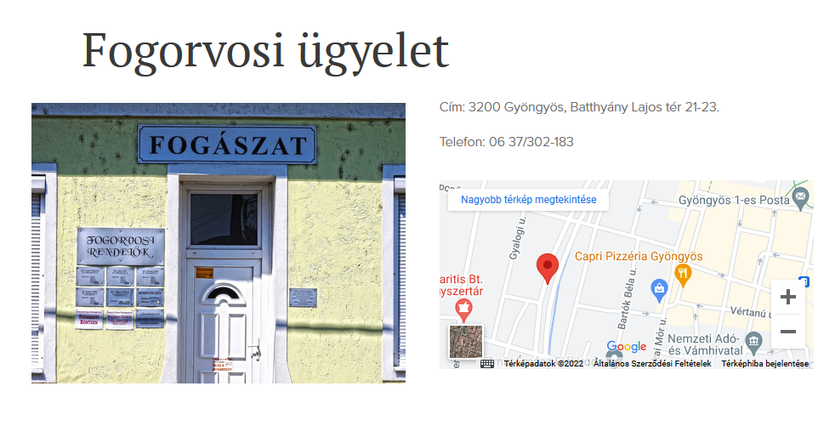
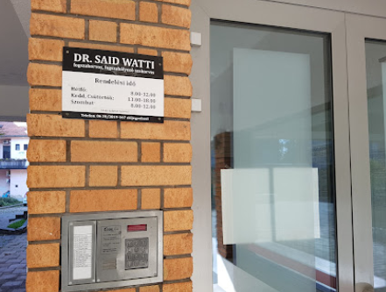
DENTIST
Zsuzsanna Varga MD
3200 Gyöngyös, Batthyány Lajos tér 21-23.
If you have a TAJ card, the dental care or surgery are FREE
WE WILL HELP YOU TO MAKE AN APPOINTMENT
Watti Said MD
3200 Gyöngyös, Belváros tér 4.
If you DO NOT have a TAJ card, the dental care or surgery MUST BE PAID

Slide 37
EMERGENCY ISSUES
Such as broken leg, or when surgery is needed:
Within the framework of emergency care, we ensure 24 hours a day that in serious, life-threatening cases requiring immediate intervention, the examination and primary care are carried out immediately at the same location. In this way, an accurate diagnosis can be made in the shortest possible time and the healing work can begin. After primary care, the patient receives further treatment depending on the nature and condition of his complaints at the site of an internal medicine or surgical specialty.
Emergency Care
Gyöngyös, Dózsa György u. 20-22.
In case of a private health insurance, check your card and dial the number indicated on the card.

Slide 38
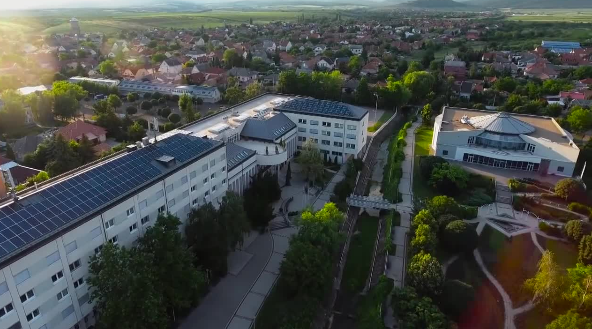
THANK YOU FOR YOUR ATTENTION!

